Slide 1
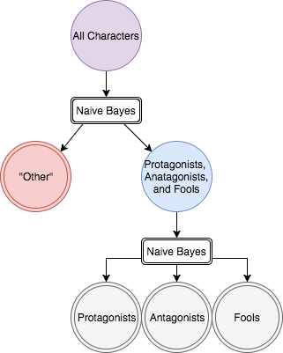
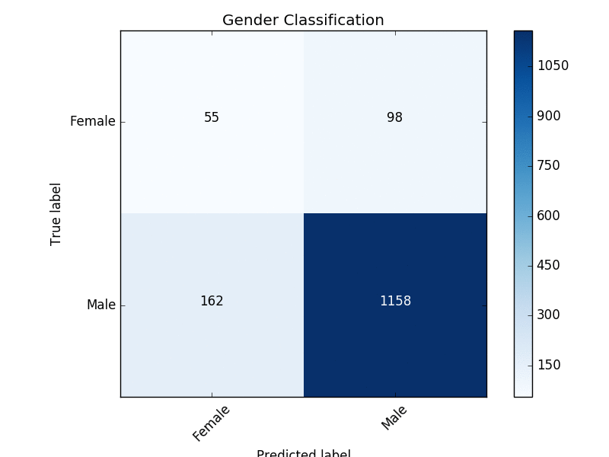
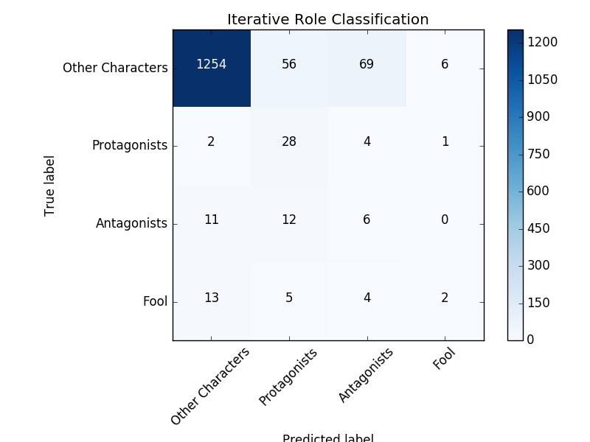
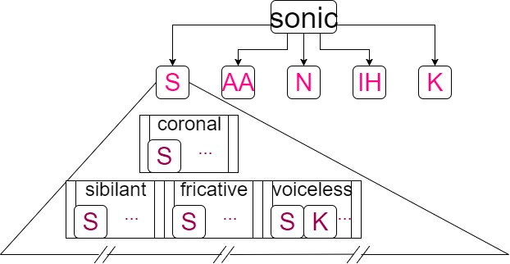
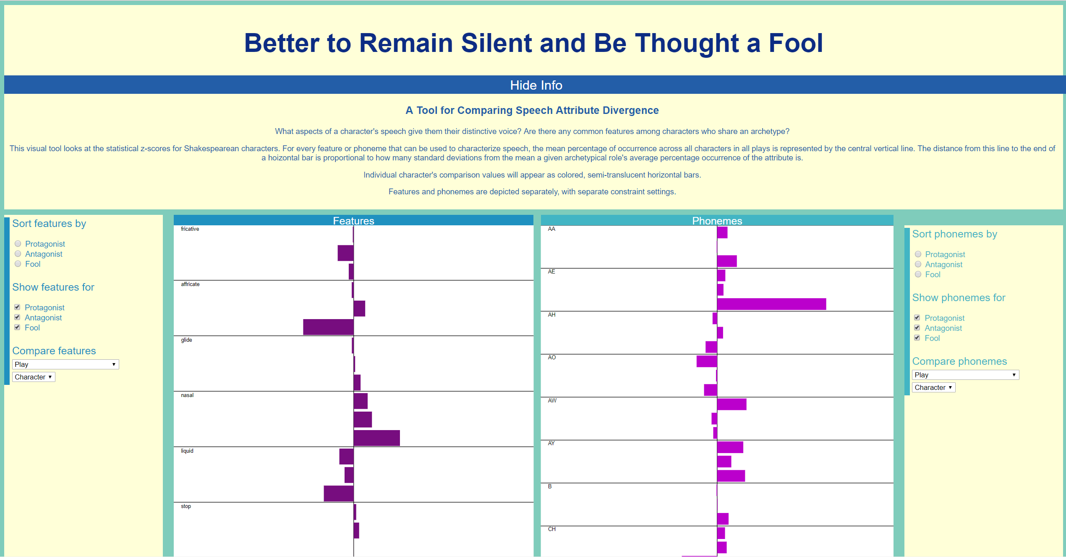
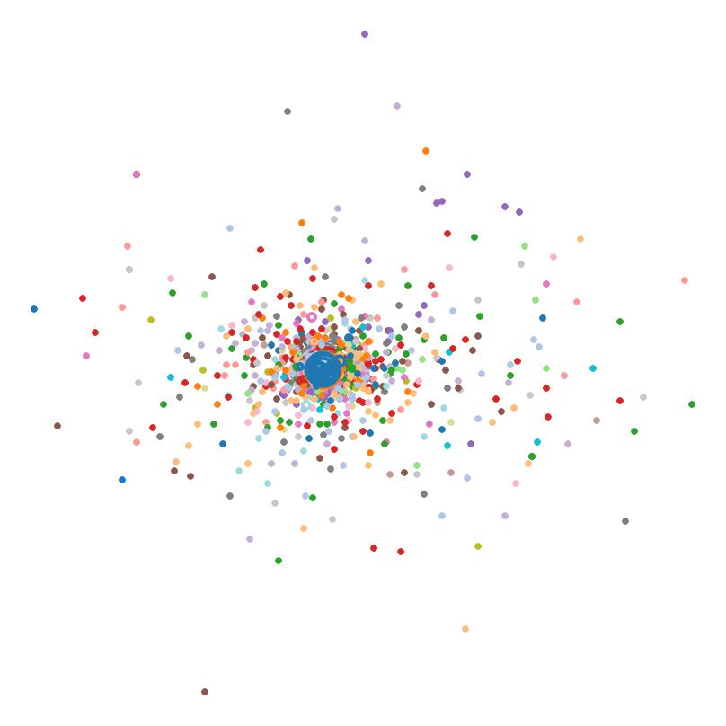
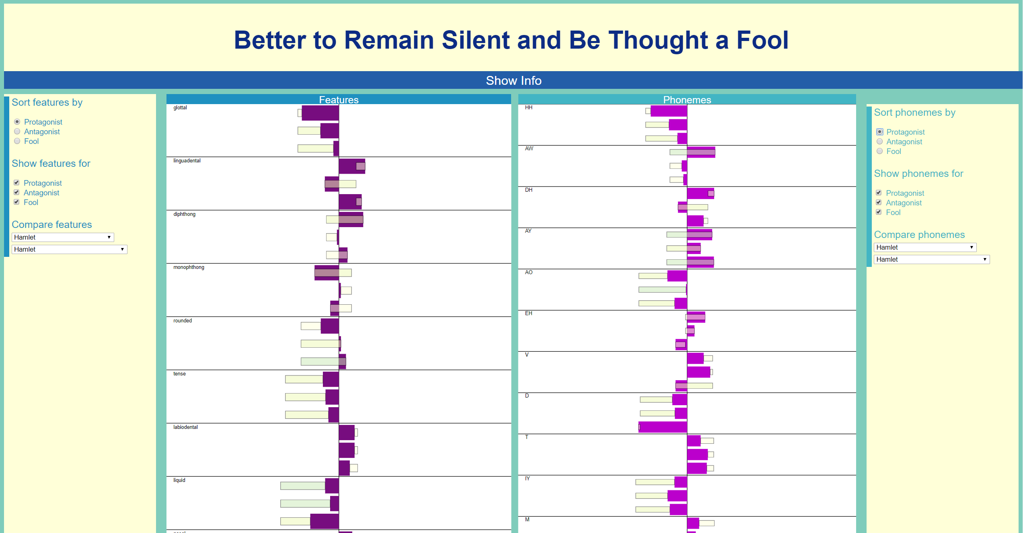

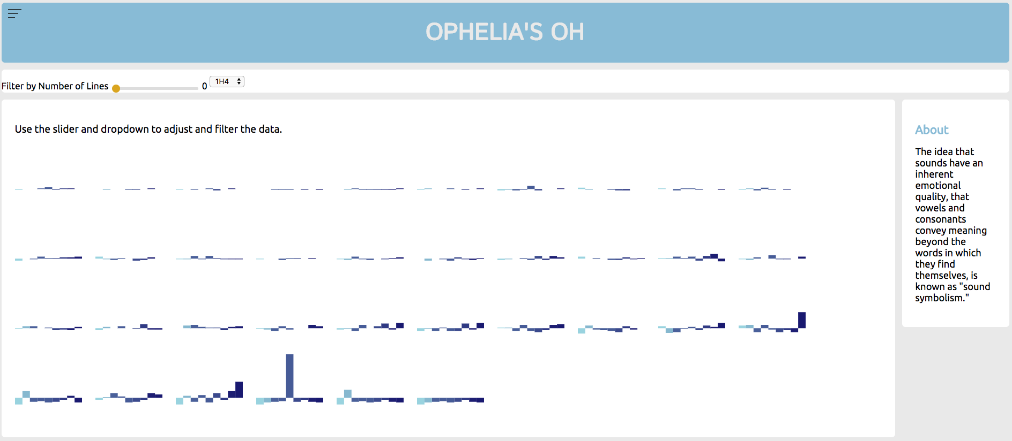
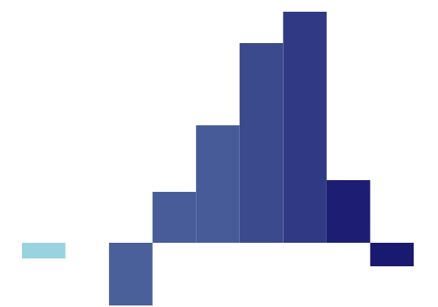
Sonic Signatures: Do Shakespeare’s Characters Have Distinct Speech Qualities?
Estelle Bayer, Liz Nichols, Eric Alexander
Computer Science, Carleton College
Why Sonic Signatures?
Naïve Bayes Classification
Linguists theorize that the sounds that make up
a word have autonomous meaning. When researchers make up gibberish words for objects, people tend to agree on which gibberish words should refer to small and large objects. When close reading a poem, readers pay attention to assonance and consonance and draw meaning from the repetition of sounds.
Is it then possible to visualize how a character “sounds”?
Do female characters have a different sound pattern than male characters?
Do protagonists sound different from antagonists?
Are characters differentiable from one another based on how they sound?
Having extracted phoneme and feature data, we wanted to see if simple classifiers could use these data to differentiate between different types of characters.
We performed iterative Bayes classification by first filtering out any character classified as “other” before re-classifying the remaining characters as antagonists, protagonists, or fools.
We achieved highest success when training data was weighted by number of speaking lines, and role determination was done iteratively. The classification results for gender are comparable to previous results based on text analysis, and
the role classification was particularly successful at filtering out “other”
characters and identifying protagonists.
Quantifying “How Characters Sound”
The iterative naïve Bayes process yields more useful results in highly unbalanced data sets
Predicted label
Predicted label
Words break down into a set of fundamental elements called phonemes. Every phoneme has an associated list of features which describe the physical processes necessary to produce it. We analyzed characters using the types of sounds they made and the specific sounds they made.
The word “sonic” decomposes into five distinct phonemes.
Confusion matrix resulting from weighted naïve Bayes classification of gender
Confusion matrix resulting from weighted iterative naïve Bayes classification of role
Z-Score Comparisons
Do certain speech attributes occur with higher frequency than average among specific archetypes?
Once we established standards for specific roles, we wanted a way to visually compare the deviation from norm for any given character to those norms.
The interactive z-score visualization allows users to sort features and phonemes by descending order of significance for a role; view only certain roles; and view the distance between a character’s z-scores and the averages for a role.
The central line in each chart represents an abstracted mean value for the given characteristic among all roles. The distance between this central axis and the end of a bar scales with the number of standard deviations from the mean exhibited by a specific role, on average, or a specific character. The left edge corresponds to two or more standard deviations below the mean, and the right edge to two or more standard deviations above the mean.
This tool allows us to explore how far any given character’s sonic signature deviates from the role averages for protagonists, antagonists, and fools.
The phoneme “S” has features including coronal, sibilant, and fricative.
Depicting Features
An incomplete view of the basic view of z-score data for phoneme and features of archetypical roles, without any comparisons
We turned each character’s speech into a vector in order to explore and compare characters’ sonic signatures.
A partial view of the comparison between Hamlet’s Hamlet and the standards for all archetypes, sorted by highest significance for protagonists
A multi-dimensional scaling, color-coded by play and with number of lines encoded as size of bubble.
What Next?
Beyond Shakespeare:
Expand our analysis to other authors, not limited to playwrights
or anglophones, with a particular interest in the role of verse and prose. Does the significance of sonic signatures change across form and language?
Word Choice Covariance:
Previous work has shown that word-based analysis yields promising categorization results, so do sonic signatures provide unique features, or merely reflect the same information as the words they comprise? To what degree are sonic signatures covariant with word choice in determining classification?
“Ophelia’s Oh”
Stanley Newman, in his experiments in Sound Symbolism, scaled vowels from bright to dark in how subjects perceived them. “IH” as in “Lit” sounded brightest and smallest, while “UH ” as in “Put” sounded darkest and biggest.
We wanted to create a visualization to examine which characters, if any, tended toward bright or dark vowels, so bars below the line represent below average usage of a vowel, while bars above the line represent above average usage of a vowel. Brightly colored bars represent brightly scaled vowels, while dark bars are dark vowels.
This tool allows us to see at a glance that certain characters do, indeed, have “brighter” or “darker” overall characterization to their speech.
Preview attachment Screen Shot 2017-08-18 at 3.44.53 PM.png
Screen Shot 2017-08-18 at 3.44.53 PM.png
6.9 KB
Preview attachment Screen Shot 2017-08-18 at 3.46.01 PM.png
Screen Shot 2017-08-18 at 3.46.01 PM.png
11 KB
Claudio
References
Rosalind
Scikit-learn: Machine Learning in Python, Pedregosa et al., JMLR 12, pp. 2825-2830, 2011.
Olson M. Determining the gender of Shakespeare’s characters. Stanford University[Internet]. 2013.
Bird, Steven, Edward Loper and Ewan Klein (2009), Natural Language Processing with Python. O’Reilly Media Inc.
Folger Shakespeare Library. (n.d.) Shakespeare's Plays, Sonnets and Poems from Folger Digital Texts. Retrieved from www.folgerdigitaltexts.org
To the left are two distinctive sonic signatures that one might compare using the tool – Rosalind and Claudio. At a glance you can see quickly that one has dark bars above the line and one has dark bars below the line.
Thank you to Carleton College and Mike Tie for supporting this research

